Slide 1
Fundamentals of Computer Programming Introduction.
Week 1 | Lecture 1 (1.1)
Notes:
Welcome back,
Congrats on first term, you survived the hardest term, keep it up
Why are you here? This is the Fundamentals of Computer Programming, and we are going to teach coding from scratch, assuming no prior knowledge.
By the time this course is done, our big learning outcomes are for you to 1) Learn the basics of coding 2) Get excited and enjoy coding and 3) see how coding fits into your discipline, and I’ll touch on all these things today

Slide 2
This Week’s Content
Lecture 1.1
Introduction – Why Programming?
Lecture 1.2
Computers, Programs, and The Coding Toolbox
Lecture 1.3
Variables, Expressions, and Operators
Notes:
This week’s plan will be a gentle easing into the world of programming.
Next class we will talk about the tools and programs we’ll be using in this course, please install these beforehand

Slide 3
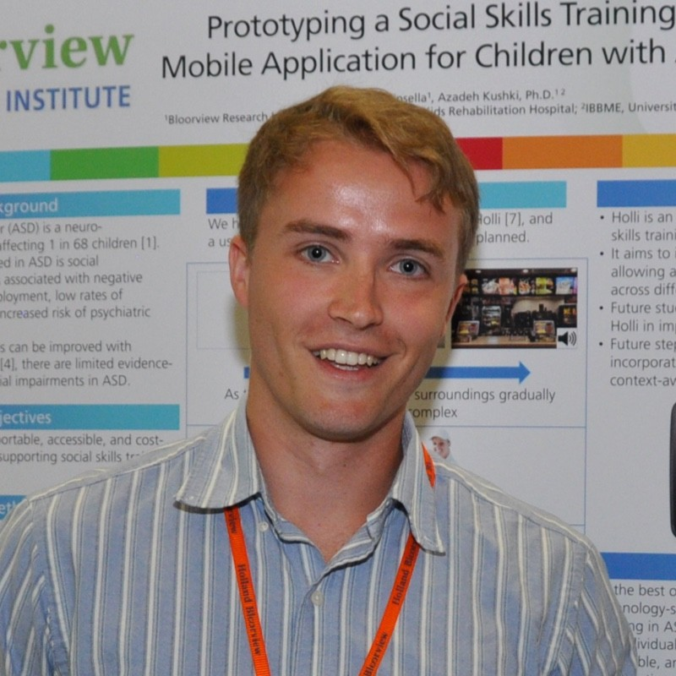

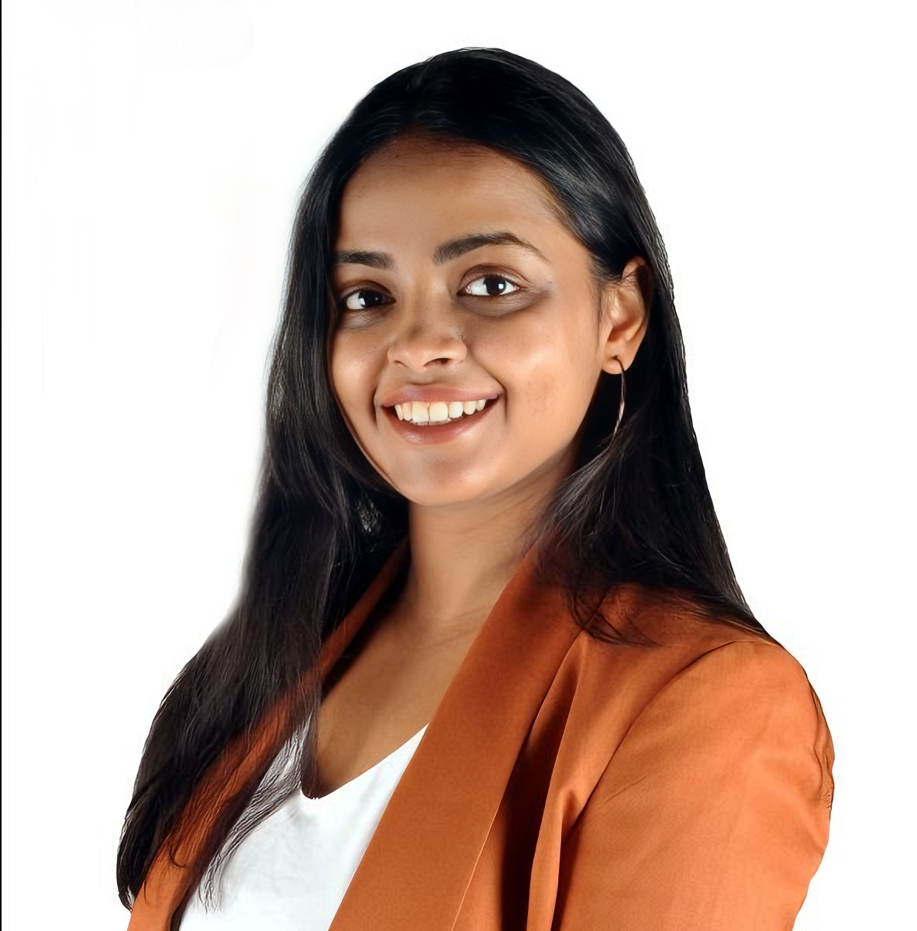
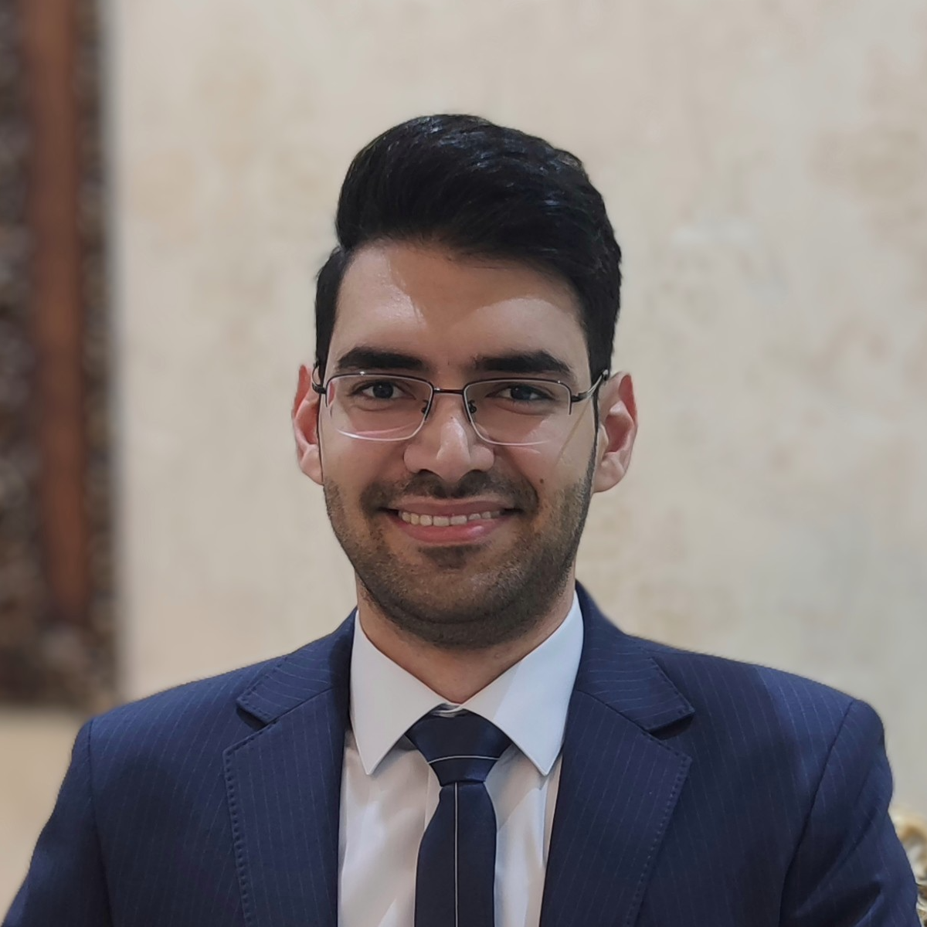
Teaching Team
Ben
Instructor
Seb
Instructor
Tanishka
TA
Sina
TA
Notes:
But first, an intro!

Slide 4
Ben
Bachelor of Electrical & Biomedical Engineering @ McMaster University 2015
Realized the power of programming (and how it can be used for good, not evil)
Master of Biomedical Engineering @ University of Toronto 2020
Hold up… people will pay me for ‘playing’ on my computer?
In between obtaining degrees I spent time programming a few different projects…
Notes:
Started at 13, neighbours computer, that culminated in high school grad prank where I wrote a virus that melted most of our library’s computers.
Fortunately, high school teacher pushed me into engineering to help channel some of this, and by second year I was working with the FYO to and using machine learning to predict, as early as possible in the term, which students would fail out, so we could proactively reach out before they even know they are at risk of failing out.
I spent a few years working at hospitals in Toronto and eventually I started exploring job opportunities outside of Canada, I was limited by a lack of a graduate degree, so I came back to U of T to get my Masters in Biomed Eng. Just FYI, if you want to work in countries without citizenship, engineering companies usually only hire graduate degrees.
All of the sudden, with my experience and the contacts I made in graduate school, I was being offered more money than I’ve ever even seen in my bank account, for a weekend’s worth of work. So when Seb and I talk about this being a valuable skill, we mean it in more ways than one
Throughout this time, I worked out of different hospitals

Slide 5
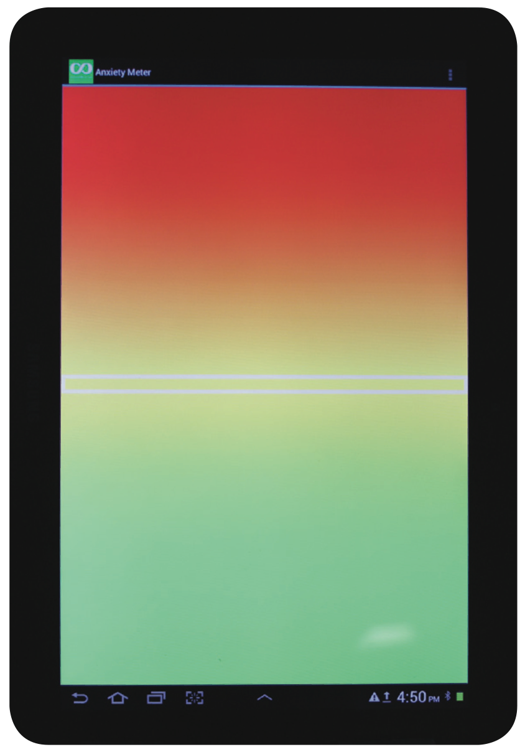


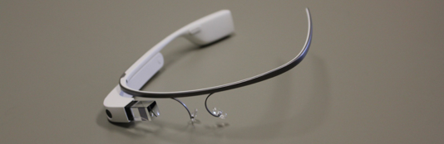

Projects for children with autism spectrum disorder
Hi!

Slide 6
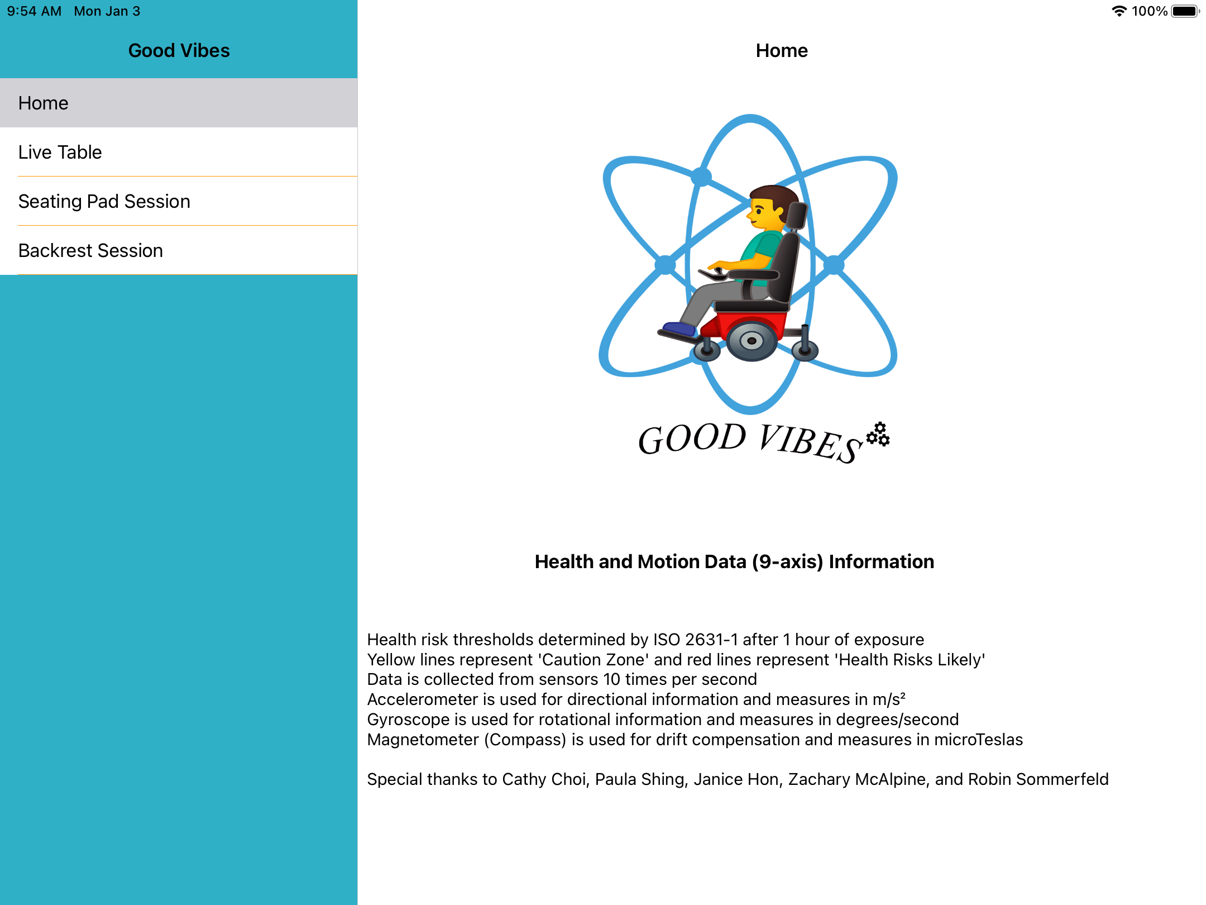
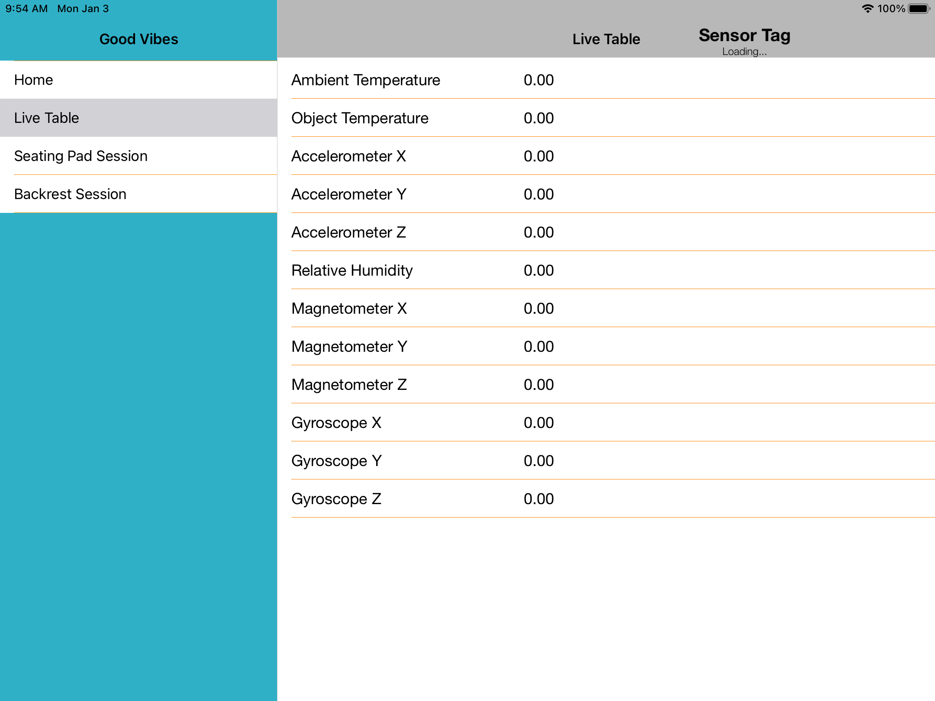
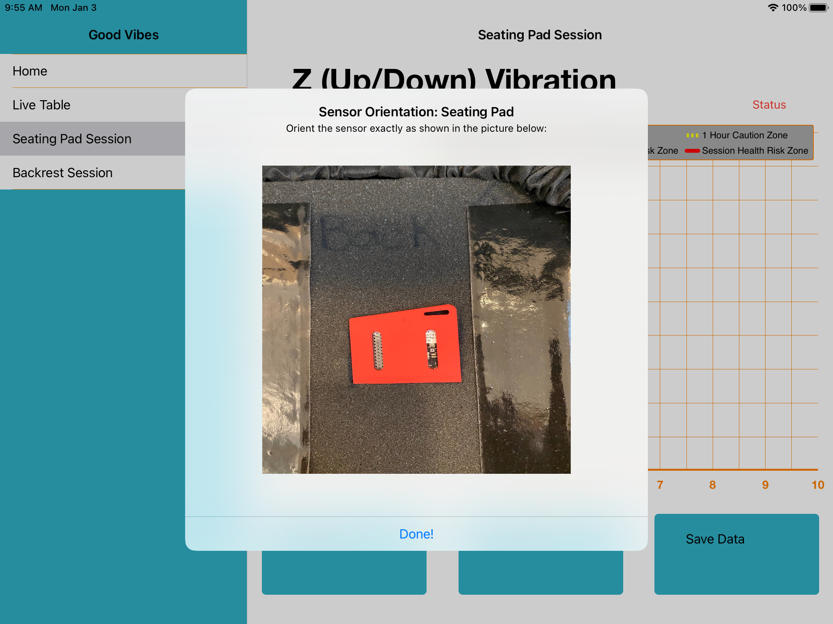
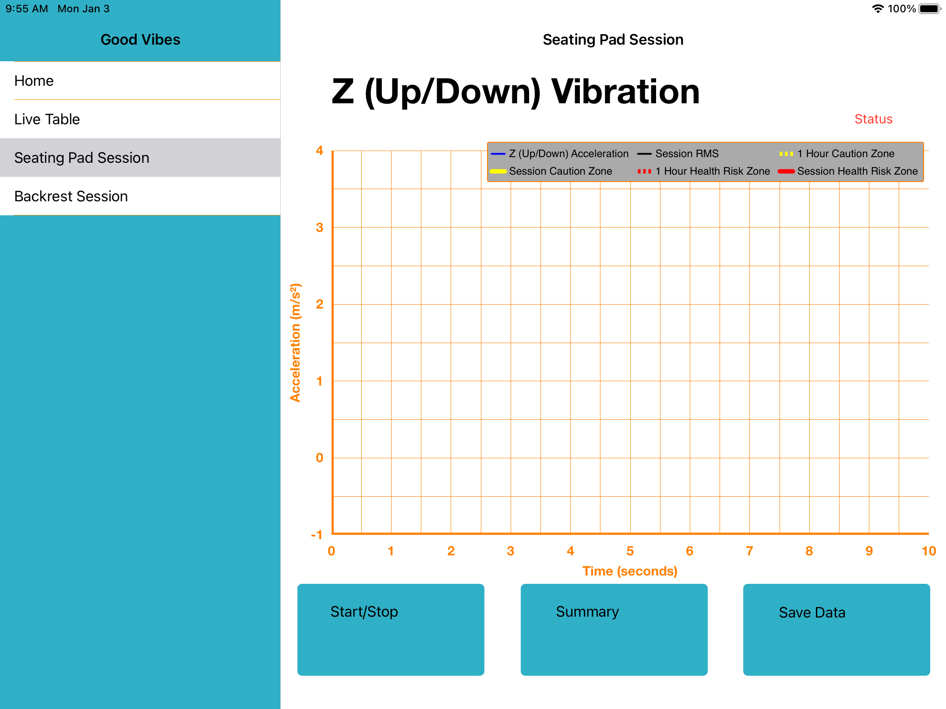


Good Vibes A wheelchair vibration measurement tool

Slide 7
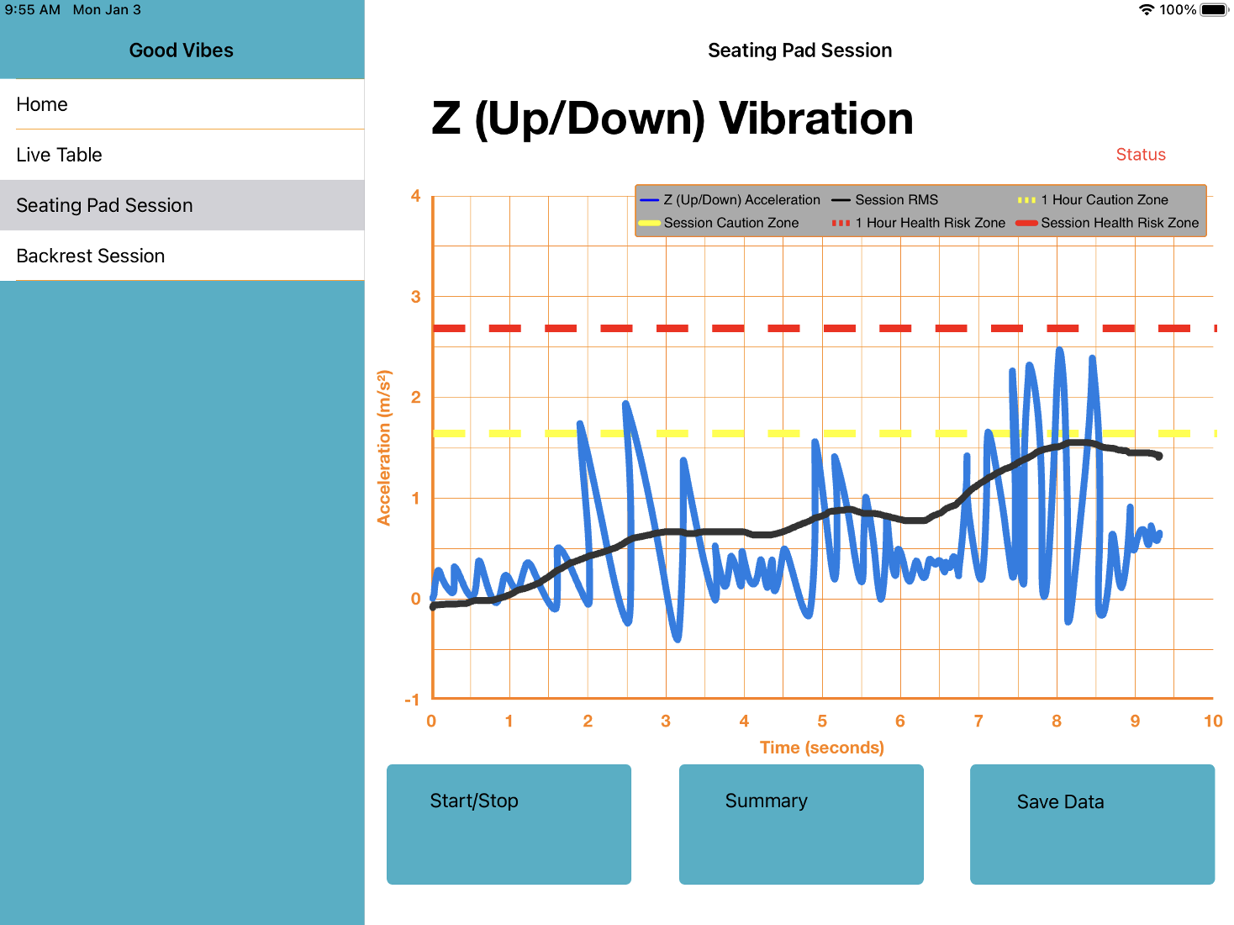

Slide 8
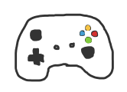

More about Ben…
Notes:
Anytime you want to chat about cats, country music, the leafs, Disney, marvel, or you’ve got some spicy food recommendations, let me know

Slide 9



Seb
Completed CivMin PhD in 2014 where I studies rock fracture and seismology (RFDF).
Senior Director of Product & AI at KORE Geosystems, a mining tech startup.
Senior Research Scientist at SickKids.
Joined UofT CivMin in January 2020.
Research topics: rock mechanics, ultrasonics, signal processing, computer vision, applied machine learning in mining.

Slide 10
Seb
Completed CivMin PhD in 2014 where I studies rock fracture and seismology (RFDF).
Senior Director of Product & AI at KORE Geosystems, a mining tech startup.
Senior Research Scientist at SickKids.
Joined UofT CivMin in January 2020.
Research topics: rock mechanics, ultrasonics, signal processing, computer vision, applied machine learning in mining.

Slide 11
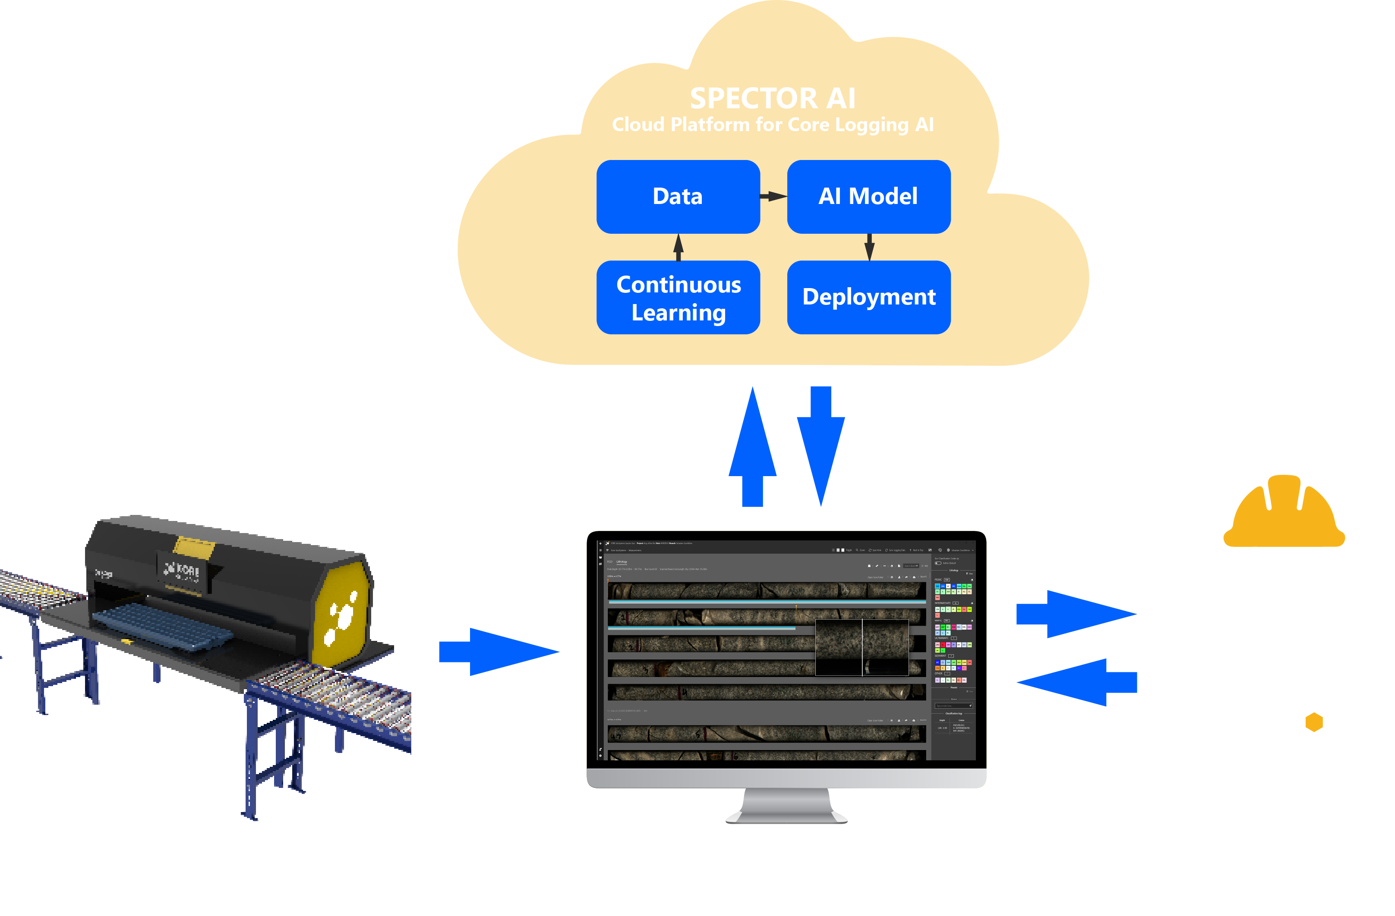
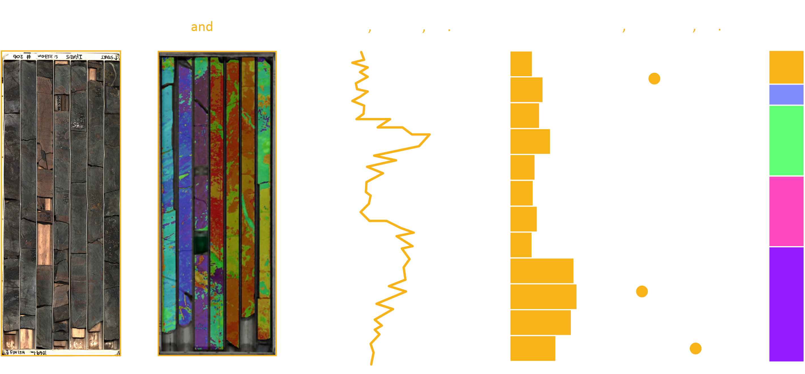
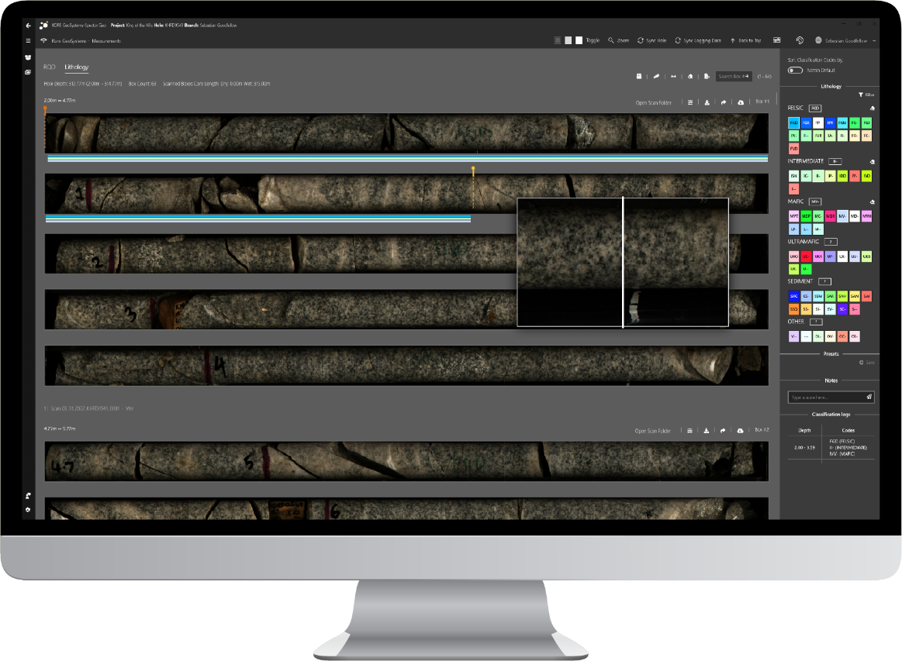
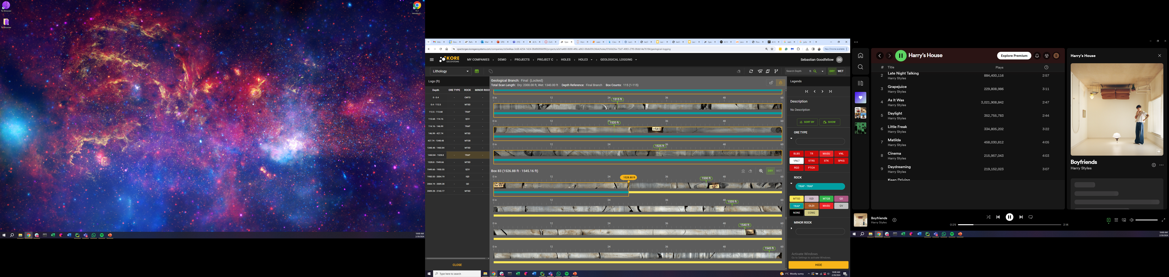
Building Tech in Mining
Geoscience Data.

Slide 12
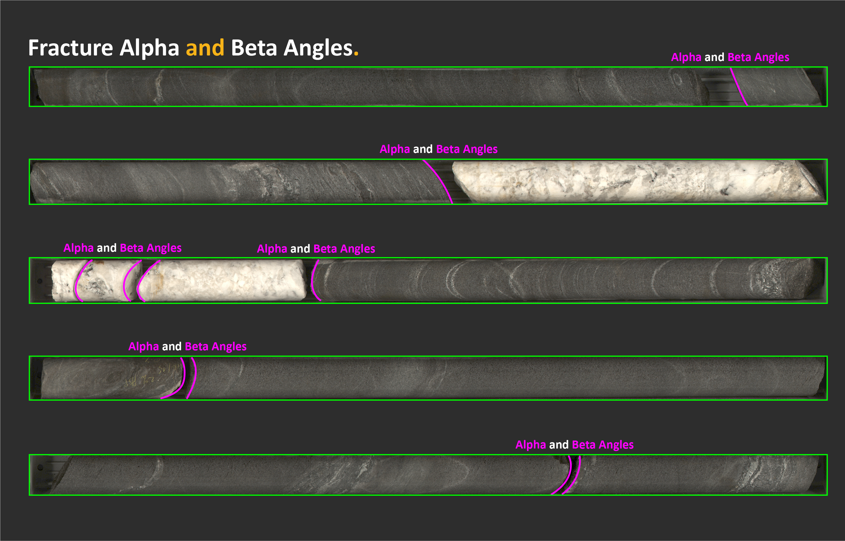
We build AI to… find fractures.

Slide 13
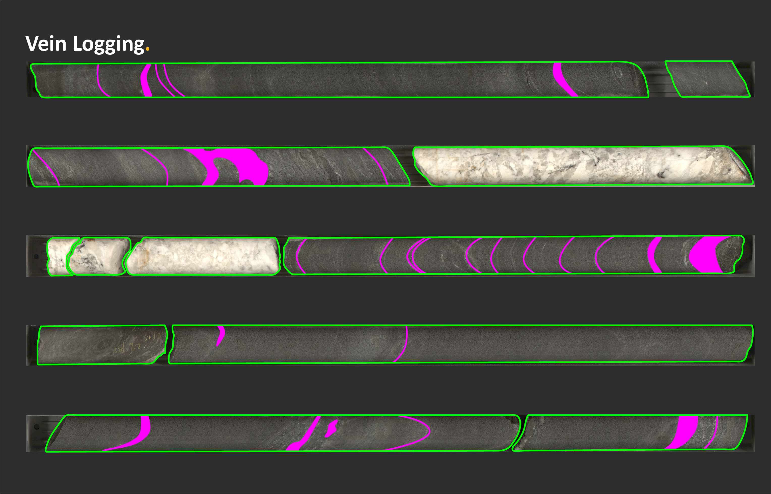
We build AI to… measure veins.

Slide 14
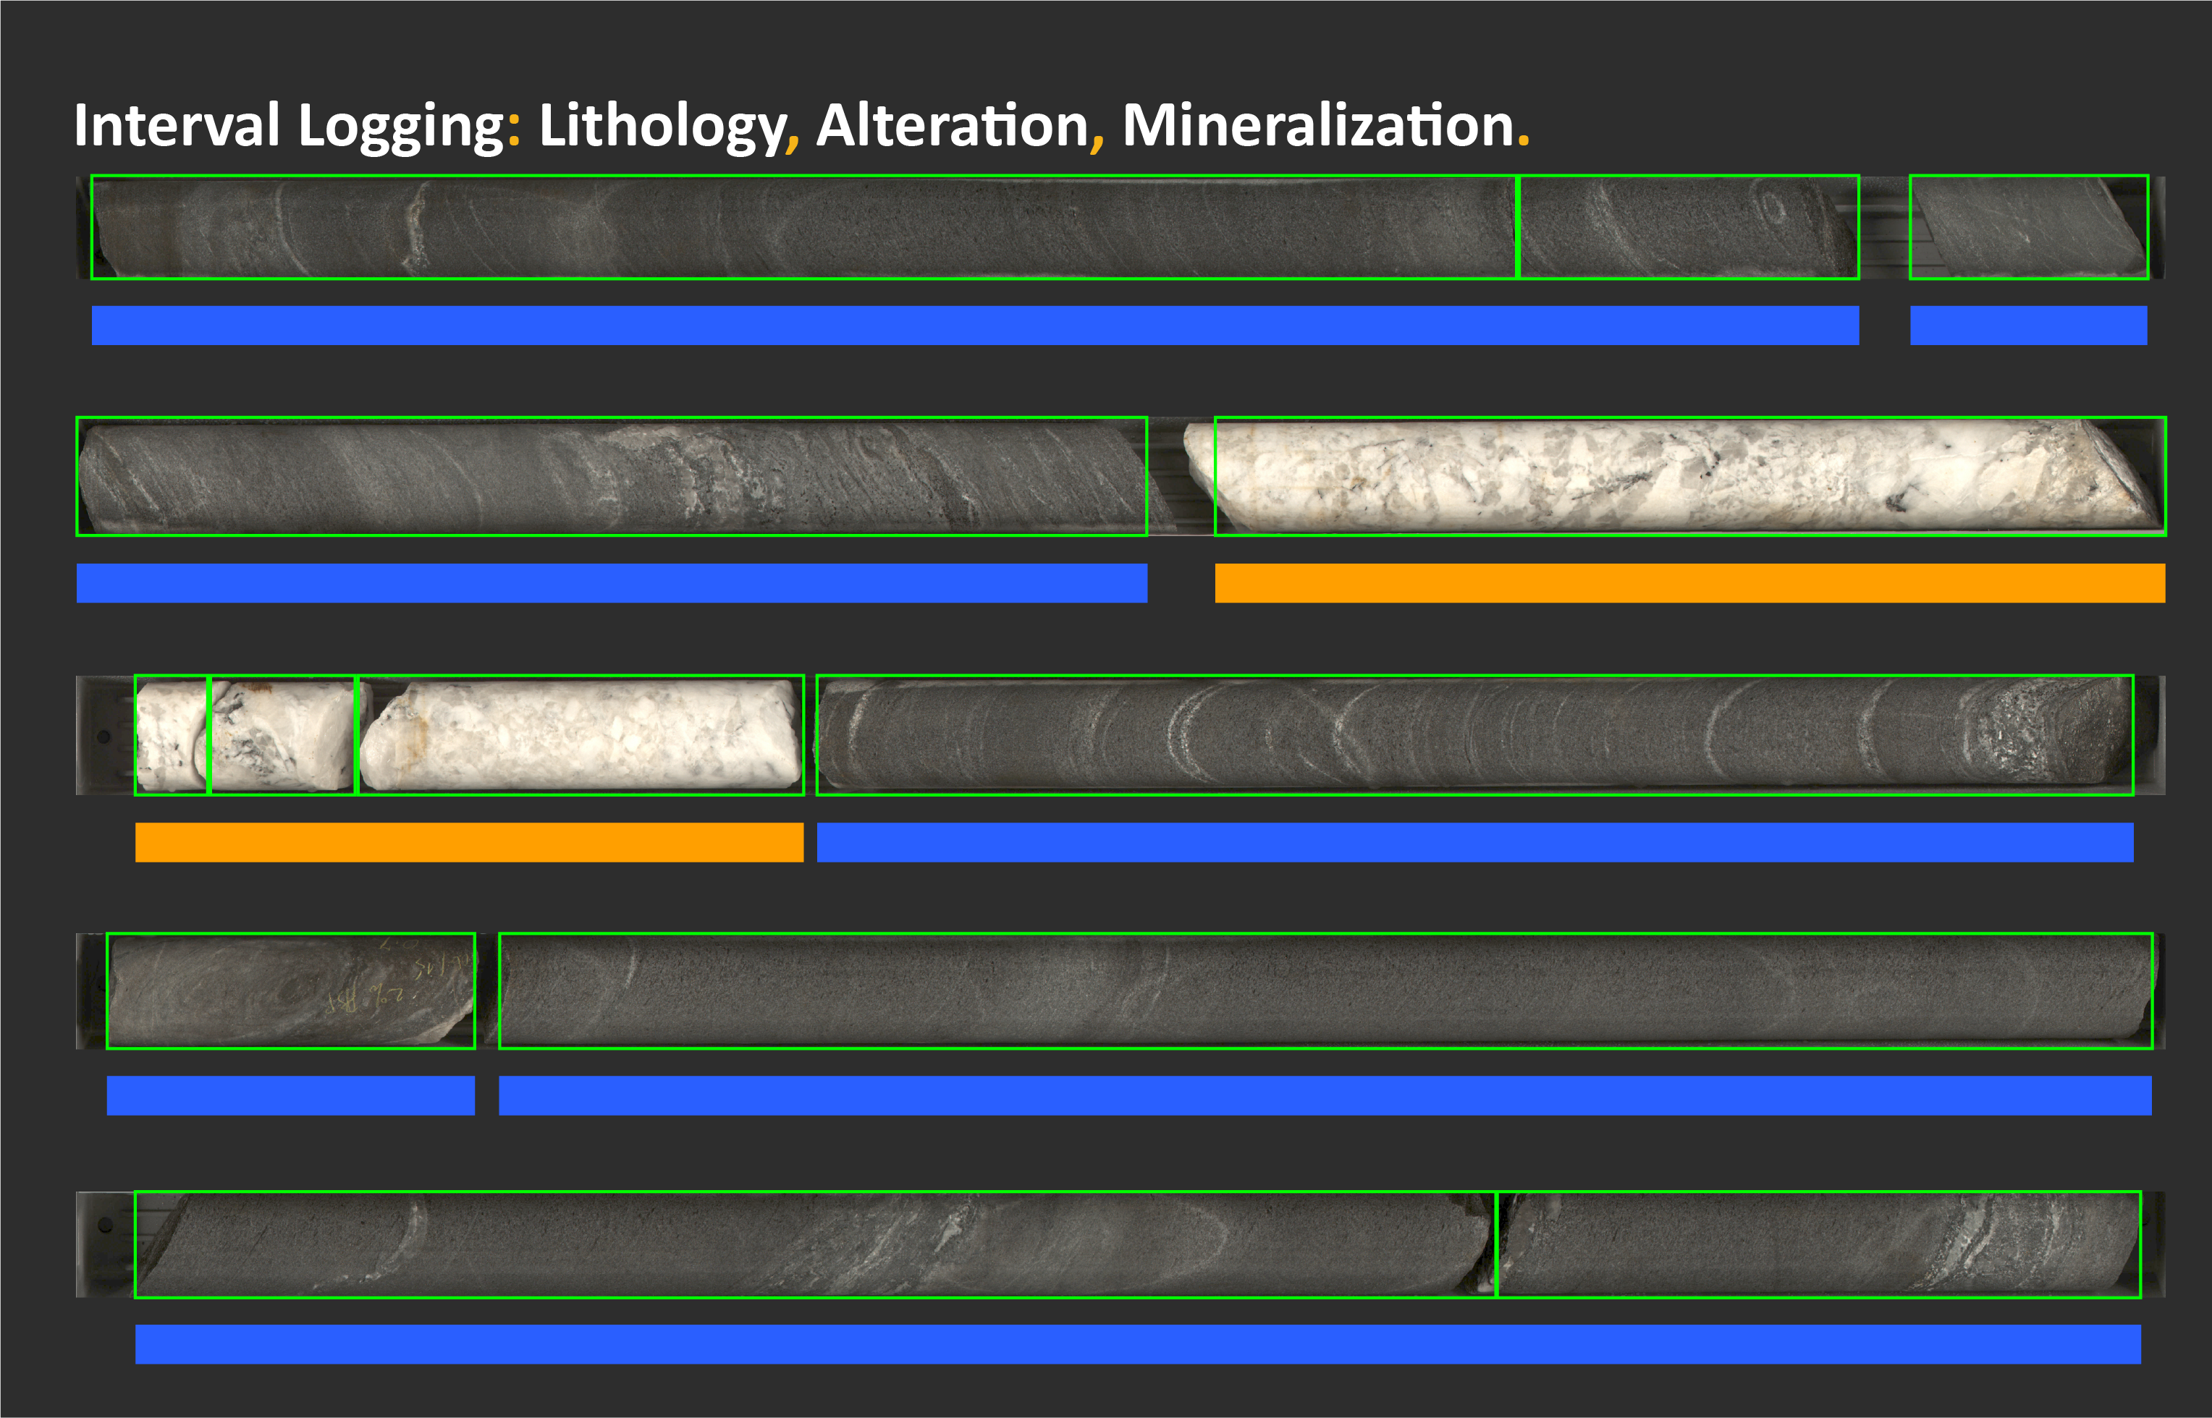
We build AI to… log rock type.

Slide 15
Seb
Completed CivMin PhD in 2014 where I studies rock fracture and seismology (RFDF).
Senior Director of Product & AI at KORE Geosystems, a mining tech startup.
Senior Research Scientist at SickKids.
Joined UofT CivMin in January 2020.
Research topics: rock mechanics, ultrasonics, signal processing, computer vision, applied machine learning in mining.

Slide 16


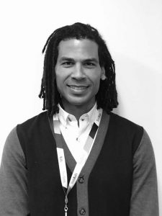



AI assistance in healthcare.
AI Diagnosis
JET 98%
AI
Detects
JET
Pages
Mjaye
Staff Physician
Nurse
Confirm
12-Lead
JET
Onset
5 minutes later
Treatment begins
AI
Notes:
Video Start: 16:02
JET Starts at 13:97

Slide 17

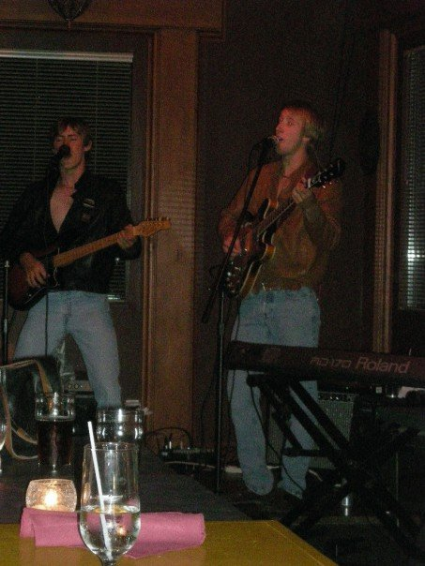
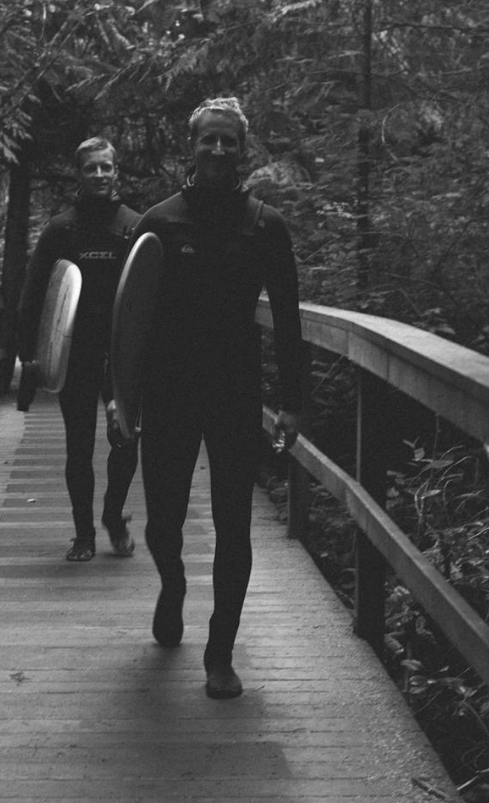



I like doing other things
I love travelling and have visited over 20 countries including France, Switzerland, Italy, Austria, Croatia, Costa Rica, Nicaragua, Panama, Peru, Bolivia, United States, Egypt, Turkey, Morocco, South Africa, and Namibia.
I was a founding member of Ottawa’s premiere Beatles cover band.
I love camping, hiking, and surfing.
I have a wonderful baby boy named Avery Goodfellow and baby girl name August.
I love building things with code ( Seb-Good).

Slide 18
Tanishka
Doing a Master's in Management Analytics.
🎵 Pursuing a Master’s in Indian Classical Vocals as a side passion.
💻 Professional Experience:
Worked at Goldman Sachs as a Data Engineer for 2.8 years.
Built cool AI tools using Python that automated document information extraction enhacing productivity across 60+ global teams.
🌄 Adventurer:
Passionate solo traveler who loves hiking and exploring new places.
Completed a surfing course and a Level 1 solo paragliding program.
🎨 Creative Passions:
Enjoy painting, dancing, and playing classical string instruments like – Sitar, Santoor and more.

Slide 19
Sina
Pursuing a PhD in Construction Management
🌍 From Tabriz, Iran –Home of Persian rugs, luxurious leather, and Chelow Kebab (the king of all foods!)
💻 Research Interests:
Using AI to improve safety and efficiency on construction sites
Creating cool synthetic construction images with AI-powered tools
🌄 Explorer: Swimming, hiking, and discovering the world one step at a time!
🎶 Creative Soul: Singing and vibing to music
📜 History Buff: Diving deep into Persian literature and world history
🗺️ Movie Enthusiast & Traveler: From the silver screen to real-world adventures

Slide 20

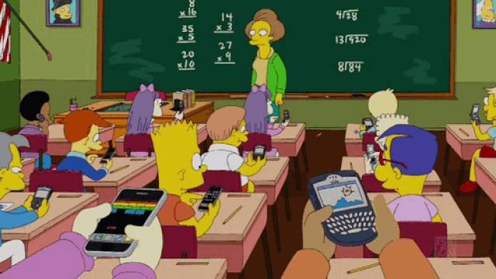
Being Respectful is an Expectation
Talking
Working on other courses
Eating
Being Late for Lectures
Notes:
The most important thing in this course is to keep up.
In class we will move fast, too fast to be distracted by other conversations and course work. Lectures will usually alternate between lecturing and in-lecture activities that give you a chance to talk and work on code with your tables, but while we’re lecturing we need your attention at the front.
Everything builds on top of each other, and by spending one lecture distracted, you’re going to really struggle with all following lectures.

Slide 21


Being Respectful is an Expectation
Talking
Working on other courses
Eating
Being Late for Lectures
Notes:
Eating – be aware desks will be full with computers and you’ll need hands to type
Late – you need to keep up in this course, if you’re late, you’ve missed content, and it will take twice as long to catch up. If you are late, please use the back doors when entering to be respectful to your classmates

Slide 22
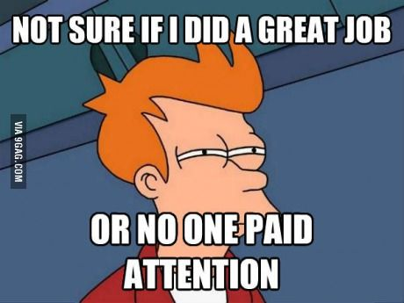
Ask Questions!
Ask questions as much as possible.
Ask as soon as you feel confused!
Ask each other questions in-person or on Piazza and help if you think you know the answer
Never forget - if you have a question, there’s always other people in the room wondering the same thing. They will be thankful you asked it!
Notes:
When no one asks questions, this is how I feel.
We have lecture TAs and a second instructor walking around throughout class to help answer questions quietly, but you can also ask the front.

Slide 23
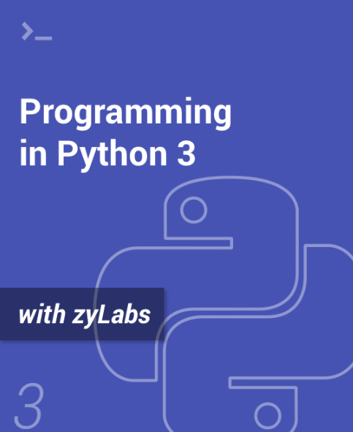
Course Information
Quercus:
APS106H1 S LEC0101 (Website contains all information).
Textbook:
Programming in Python 3.
A link to the UofT bookstore where you can purchase the textbook can be found on the Syllabus page.
Piazza:
https://piazza.com/utoronto.ca/winter2025/aps106/home

Slide 24
Grading
Petitions: First-Year Office.
Reflections (13 in total)
Labs (10 in total, 1% each)
Term Test 1 (Thurs Feb 13)
Term Test 2 (Tues March 18)
Final Exam
total: 2%
total: 10%
total: 15%
total: 23%
total: 50%

Slide 25
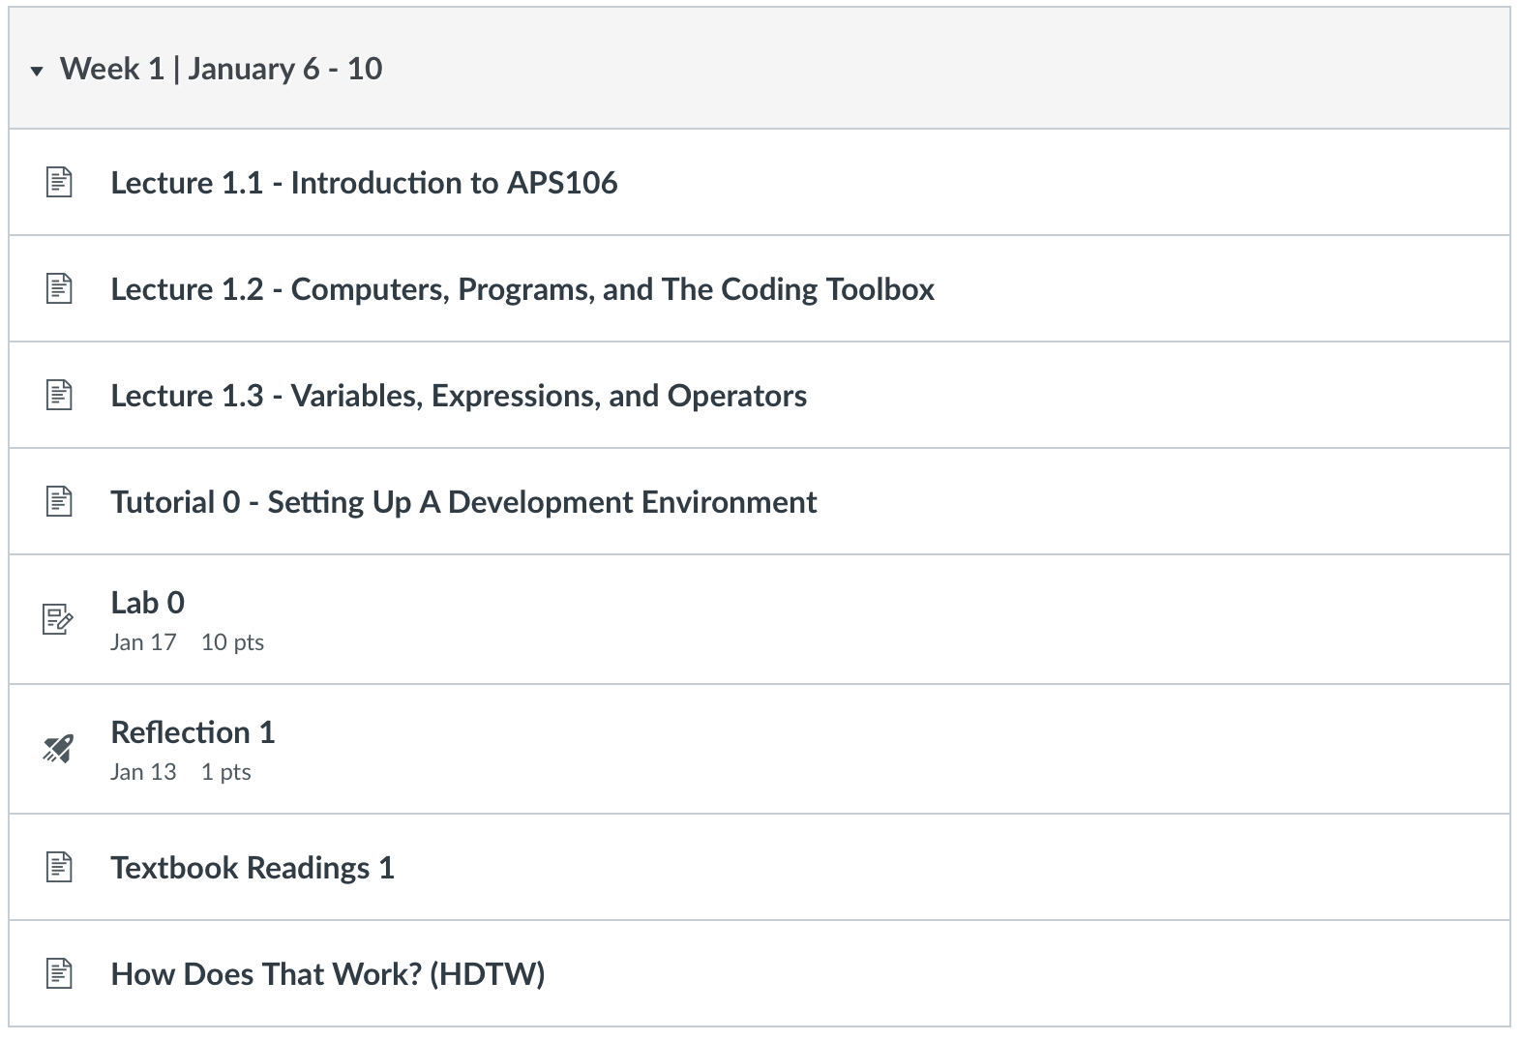
APS106 Golden Tip for Success Complete weekly modules DURING that week

Slide 26
Lecture Schedule
Section | Monday | Tuesday | Wednesday | Thursday | Friday
LEC0101 | 11:00 am - 12:00 pm |  | 11:00 am - 12:00 pm | 9:00 am - 10:00 am
Lectures will be in person in MYHAL 150.
Lecture content can be found on Quercus using the Kinsella & Goodfellow links.

Slide 27
Tutorial Schedule
One online tutorial TBD.
Week | Tut Content | Monday | Tuesday | Wednesday | Thursday | Friday
Week 1 (Jan 6 - Jan 10) | Tutorial 0 |  | TUT0102 2:00 PM - 3:00 PM TUT0105 5:00 PM - 6:00 PM |  | TUT0106 12:00 PM - 1:00 PM TUT0101 3:00 PM - 4:00 PM TUT0104 3:00 PM - 4:00 PM TUT0108 5:00 PM - 6:00 PM | TUT0103 3:00 PM - 4:00 PM TUT0107 3:00 PM - 4:00 PM
Week 2 (Jan 13 - Jan 17) | Tutorial 1 |  | TUT0102 2:00 PM - 3:00 PM TUT0105 5:00 PM - 6:00 PM |  | TUT0106 12:00 PM - 1:00 PM TUT0101 3:00 PM - 4:00 PM TUT0104 3:00 PM - 4:00 PM TUT0108 5:00 PM - 6:00 PM | TUT0103 3:00 PM - 4:00 PM TUT0107 3:00 PM - 4:00 PM
Notes:
No tutorials week 1

Slide 28
Lab Schedule
Week | Monday | Tuesday | Wednesday | Thursday | Friday
Week 1 (Jan 8 - Jan 12) |  |  |  | Lab 0 Released 6:00 PM | PRA0108 3:00 PM - 5:00 PM
Week 2 (Jan 15 - Jan 19) | PRA0107 10:00 AM - 12:00 PM PRA0104 12:00 PM - 2:00 PM PRA0101 1:00 PM – 3:00 PM | PRA0106 4:00 PM - 6:00 PM PRA0111 4:00 PM - 6:00 PM | PRA0109 3:00 PM - 5:00 PM PRA0110 4:00 PM - 5:00 PM | PRA0102 10:00 AM - 12:00 PM PRA0103 10:00 AM - 12:00 PM PRA0105 4:00 PM – 6:00 PM Lab 1 Released 6:00 PM | PRA0108 3:00 PM - 5:00 PM Lab 0 Due 11:59 PM
Notes:
Lab 0 released this Thursday, PRA start this Friday.

Slide 29
Reflections
There are 13 reflections throughout the term.
Reflections are worth a total of 2% of your final grade.
Full marks for successful completion of all reflections.
Reflections are used to take the pulse of students in the course.
Insights from reflections are used to iteratively improve the course week-by-week.
Reflections are there to help you, so please answer honestly.

Slide 30
Reflections
Reflection include question like:
Did you attend lecture this week? If not, why?
Do you understand the topics covered this week?
Did you attend tutorial this week?
Which lecture section did you attend?
What will this code output?
Write one word to describe how you feel about the course.
Notes:
Why do we ask these questions? So we can iterate! So we can improve for YOU!
Course Evals we don’t get until after the term has ended. I STILL don’t have the course evals you provided from ESP last term. This lets us iterate for you. We want to know NOW what you don’t understand NOW so we can change lecture and tutorial content for you ASAP.
For some examples, in the past we’ve used some of the reflection data to allocate extra lecture time to recap common points of confusion, and we’ve also added extra online labs and tutorials upon student request.

Slide 31
Reflections Schedule
Week | Reflection | Monday | Tuesday | Wednesday | Thursday | Friday
Week 1 (Jan 6 - Jan 10) | Reflection 1 |  |  |  |  | Reflection 1 Released 6:00 pm
Week 2 (Jan 13 - Jan 17) | Reflection 2 | Reflection 1 Due 1:00 am |  |  |  | Reflection 2 Released 6:00 pm
Week 3 (Jan 20 - Jan 24) | Reflection 3 | Reflection 2 Due 1:00 am |  |  |  | Reflection 3 Released 6:00 pm
Week 3 (Jan 27 – Jan 31) | Reflection 4 | Reflection 3 Due 1:00 am |  |  |  | Reflection 4 Released 6:00 pm
Notes:
3 days to complete something that takes a couple minutes and is based only on your honesty.
Easiest 2% you might get in a course all term – HOWEVER, and I’m saying this because it’s happened too many times to count – not doing these really doesn’t look good on the student when we get the inevitable emails next term from students who have failed with a 48% asking us to raise their grade.
Failure in this course is a real possibility, every year students fail who don’t take this course as seriously as they should. Get the easy marks where you can, and keep up with the lecture content as much as you can.

Slide 32
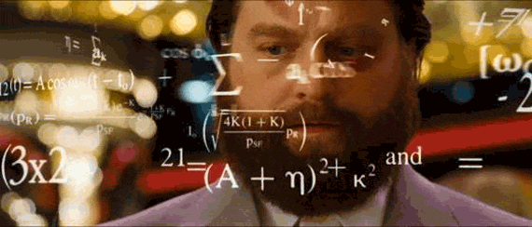
Tips for Success
Do not wait until the last minute.
Programming is a Language.
Work Together (except during the test/exam)
Work Smart (effort doesn’t necessarily equal progress).
Time Management.
Know when (and how) to ask for help.
Notes:
Keep up!
Don’t just stare at a blank file or the same bug for hours! Post on Piazza with a specific question or go to tutorial or lab to get help. You might even ask something like ChatGPT for help, which can be fine, as long as you know that you are responsible for writing code WITHOUT chatGPT for 88% of your final grade.

Slide 33
Tips for Success
88% of your final grade is based on two term tests and an exam.
For these tests and exams, you’ll be asked to write code by hand.
You will not be able to achieve a high mark by reading the textbook and lecture notes. You need to PRACTICE, PRACTICE, PRACTICE!
How can you practice writing code?
Lecture Breakout Sessions.
Labs (think of this as studying).
Practice Problems.
Writing A Lot Of Code During The Term
=
Higher Grade

Slide 34

What is this course all about?
Learn the fundamentals of programming.
Programming as a tool for all engineering disciplines.
Enjoy coding as a new and meaningful skill.
Experience engineering design through programming.
Notes:
Engineering design – You know that I teach the engineering design course, and I want to how some of those skills - whether it’s as defining the problem, brainstorming, and iteration - transfer to programming

Slide 35
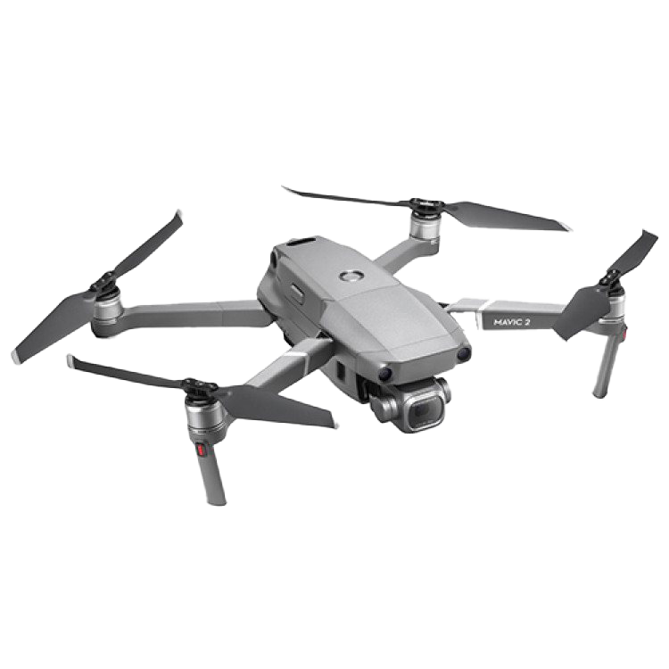

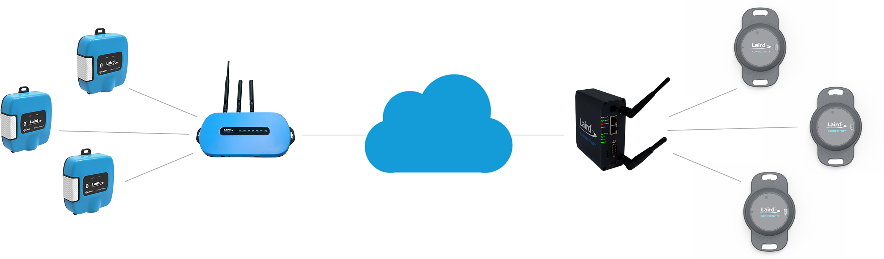

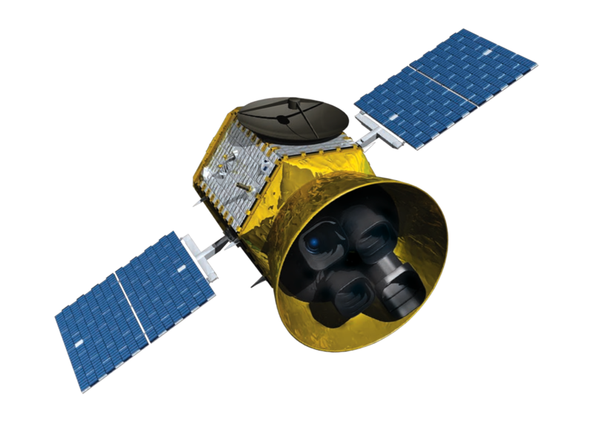
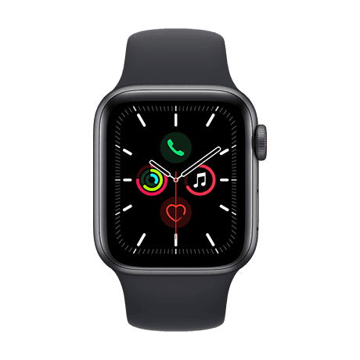
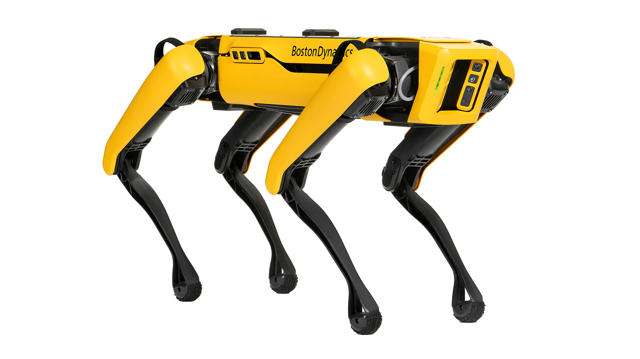
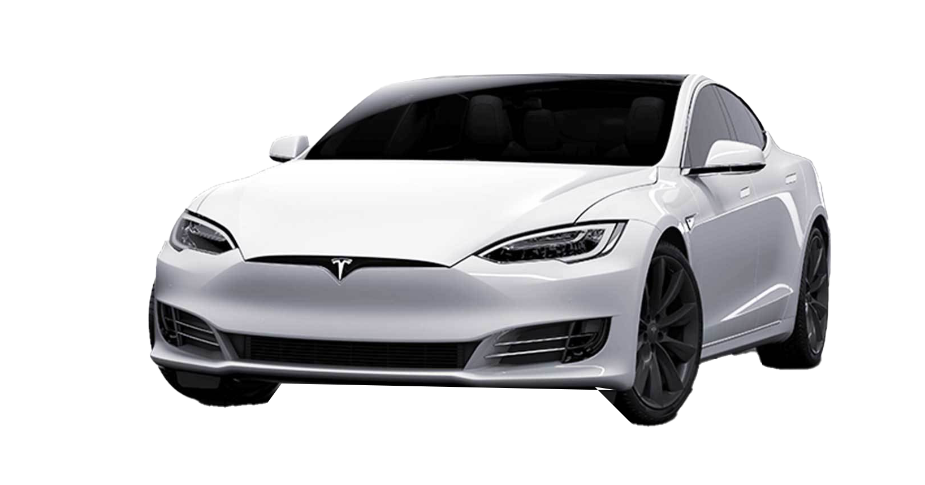
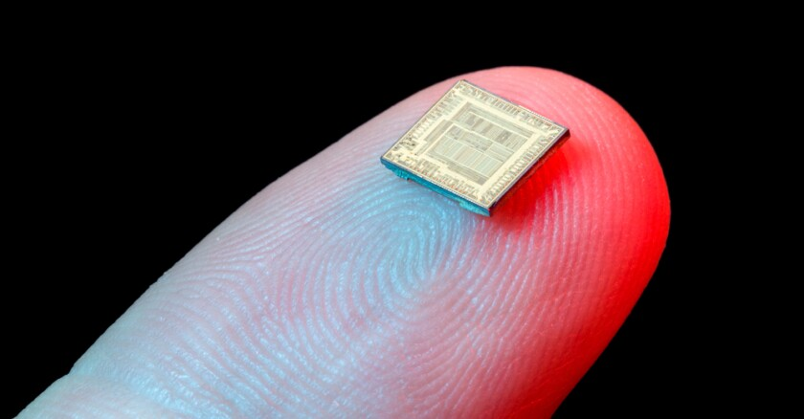
Why Programming?

Slide 36

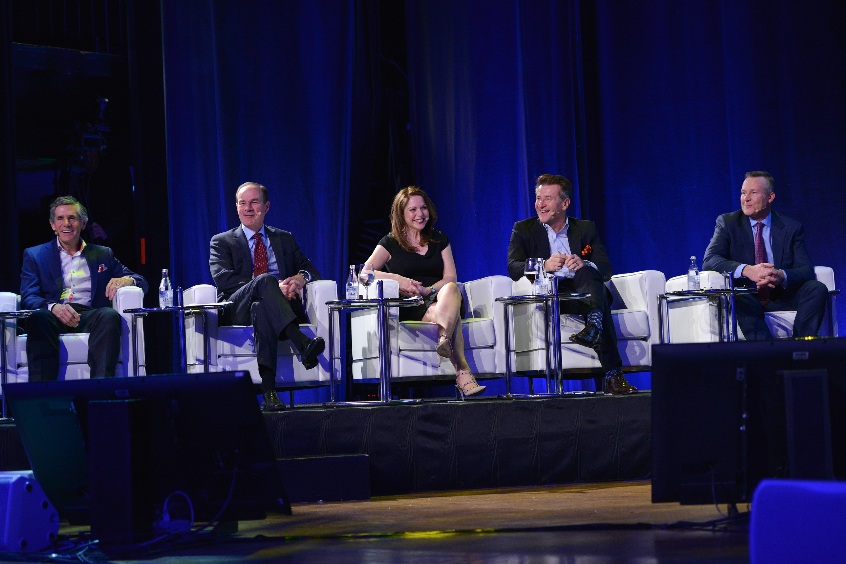
Why Programming?
Computers are everywhere:
Learn to interact with them.
Simplifies our jobs.
Entrepreneurial opportunities ($$$).
Necessary for engineering jobs.
Research and development.
Because it’s fun!
$1,000,000 Investment.
Owner of McEwen Mining Inc.
President of Cisco Systems Canada
COO of Goldcorp
CEO of Franco-Nevada Corporation
SHARK on ABC’s Shark Tank
Notes:
No other course can you lie in bed, with music or Netflix playing, and play around on your computer guilt-free

Slide 37
What is Programming?
A way of telling a computer what to do.
A computer can’t infer (…yet).
Need to tell a computer every single step it needs to do, in a language it can understand.
How would you request an egg for breakfast to a chef and to a computer/robot?
To a Chef
Sunny-side up, please!
To a Computer
“Turn on stove”
“Take out pan”
“Take one egg out of fridge”
“Crack egg”
“Pour egg into pan”
“Wait 5 minutes”

Slide 38
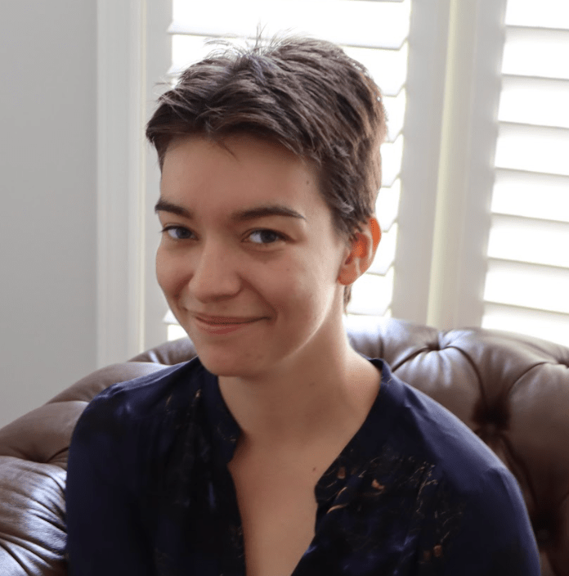

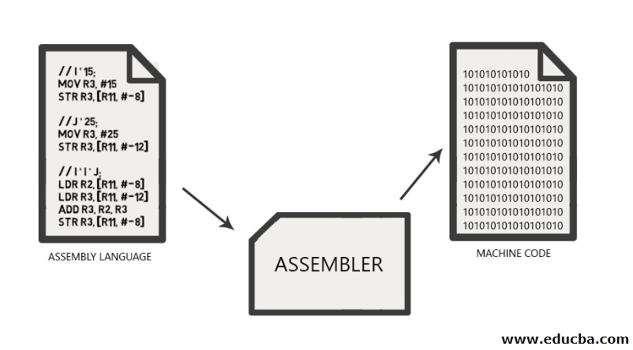
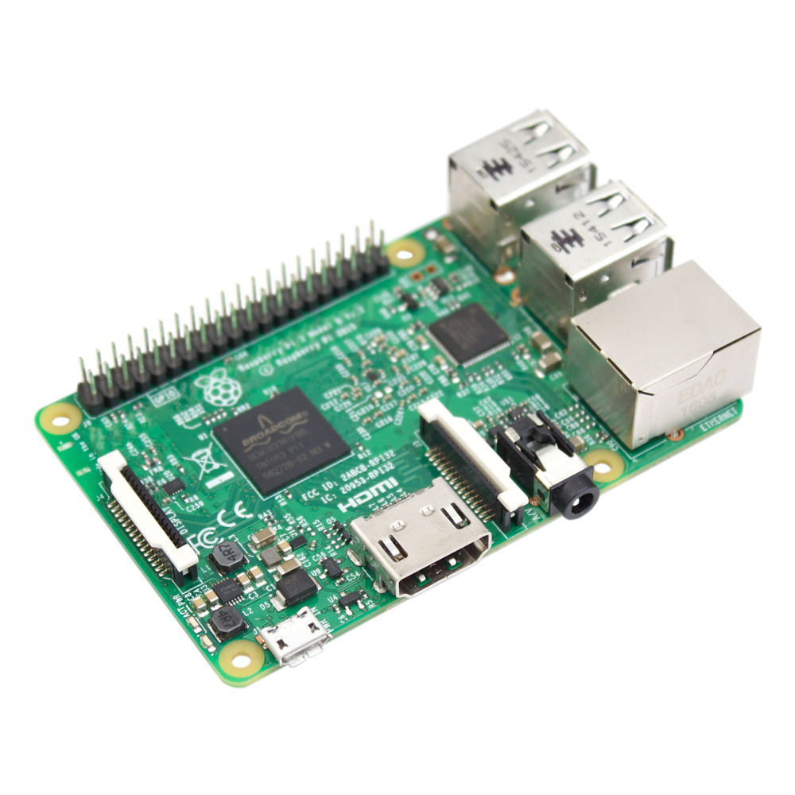
Programmer
English
How to Program a Computer.
Pseudocode
Programming Language
Compiler
Assembly Code
Assembler
Machine Code
Hardware
Notes:
We’ll talk a little bit more about assembly code vs machine code next lexture, but it’s really not important for the sake of this course.
There’s a reason we are teaching in Python

Slide 39
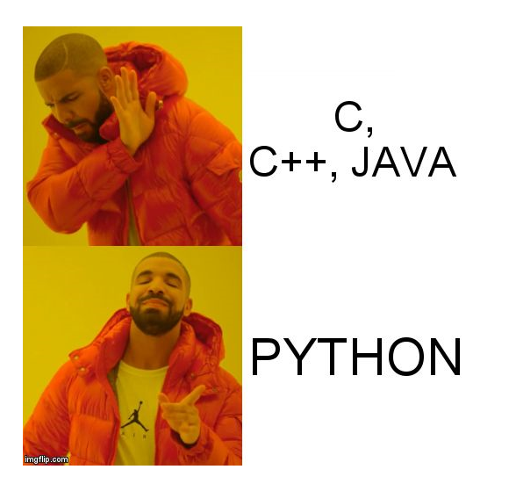
Why Python?
High-level language making it more like a readable, human language than other low-level languages.
Simple and clear syntax.
Large open-source community.
Used by Google, Firefox, Dropbox, Youtube, Instagram, Yelp, NASA, CIA, etc.
The Artificial Intelligence (AI) community overwhelmingly uses Python.

Slide 40


Why Python?
Lower-Level
High-level language making it more like a readable, human language than other low-level languages.
Simple and clear syntax.
Large open-source community.
Used by Google, Firefox, Dropbox, Youtube, Instagram, Yelp, NASA, CIA, etc.
The Artificial Intelligence (AI) community overwhelmingly uses Python.
public class HelloWorld
{
public static void main(String[ ] args)
{
system.out.println(“Hello World!”);
}
}
Higher-Level
print(“Hello World!”)

Slide 41
Why Python?
Increasing Program Size (# lines of code)
Matlab, SQL
C++, Java, Python
High-level language making it more like a readable, human language than other low-level languages.
Simple and clear syntax.
Large open-source community.
Used by Google, Firefox, Dropbox, Youtube, Instagram, Yelp, NASA, CIA, etc.
The Artificial Intelligence (AI) community overwhelmingly uses Python.
C, Fortran, Pascal
Assembly Code
Machine Code
Hardware
Increasing
Ease-of-Use

Slide 42
Why Python?
High-level language making it more like a readable, human language than other low-level languages.
Simple and clear syntax.
Large open-source community.
Used by Google, Firefox, Dropbox, Youtube, Instagram, Yelp, NASA, CIA, etc.
The Artificial Intelligence (AI) community overwhelmingly uses Python.
if x > 10:
print(“x is greater than 10”)
You don’t know Python.
Can you figure out what this code does?

Slide 43
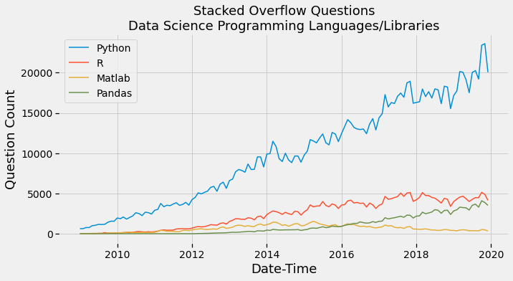
Why Python?
High-level language making it more like a readable, human language than other low-level languages.
Simple and clear syntax.
Large open-source community.
Used by Google, Firefox, Dropbox, Youtube, Instagram, Yelp, NASA, CIA, etc.
The Artificial Intelligence (AI) community overwhelmingly uses Python.

Slide 44









Why Python?
High-level language making it more like a readable, human language than other low-level languages.
Simple and clear syntax.
Large open-source community.
Used by Google, Firefox, Dropbox, Youtube, Instagram, Yelp, NASA, CIA, etc.
The Artificial Intelligence (AI) community overwhelmingly uses Python.

Slide 45









Why Python?
High-level language making it more like a readable, human language than other low-level languages.
Simple and clear syntax.
Large open-source community.
Used by Google, Firefox, Dropbox, Youtube, Instagram, Yelp, NASA, CIA, etc.
The Artificial Intelligence (AI) community overwhelmingly uses Python.

Slide 46

Why Engineers?
Ok, so we’ve explained why coding is important and why we’re learning to code in Python.
BUT, you’re all different types of engineers, right?
Mechanical
Materials
Civil
Chemical
Mineral

Slide 47
Why Engineers?
Again, why do engineers need to know how to code?
In the 20th century, engineers didn’t need to know how to code.
In the 21th century, coding is an essential skill and any engineer without solid coding abilities will be at a major disadvantage.

Slide 48





Why Engineers?
Five technology trends have changed the game for engineers.
The Cloud
Cheap Sensors
Big Data
Artificial
Intelligence
The Internet
Of Things
Notes:
Cloud - Being able to store, share, and execute things from the cloud. JupyterHub is one tool we’ll use this year that lets us save and run Python Notebooks in the cloud, without needing anything installed locally on our computer.
Cheap sensors – the example from my wheelchair app that let me have tiny sensor for $20 that let me measure everything I could possibly want, and all that data collection formed this idea of
Big Data – When we have data on everything and anything, we can start to gain insights and learn things using machine learning, which ultimately becomes the foundation artificial intelligence
AI – You’ve probably all used ChatGPT or open AI by now, so you can start to imagine how that will develop in the future.
IoT – which is kind of a combination of all of these things, but provides us with Smart Homes and enables the futuristic world where you can drive home and as soon as you get in driveway your lights turn on and your oven starts pre-heating.

Slide 49
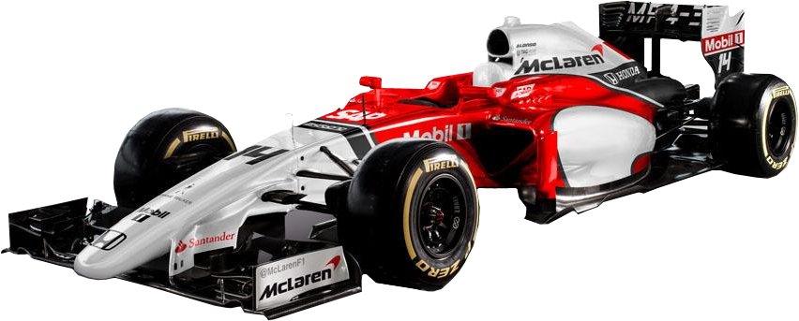
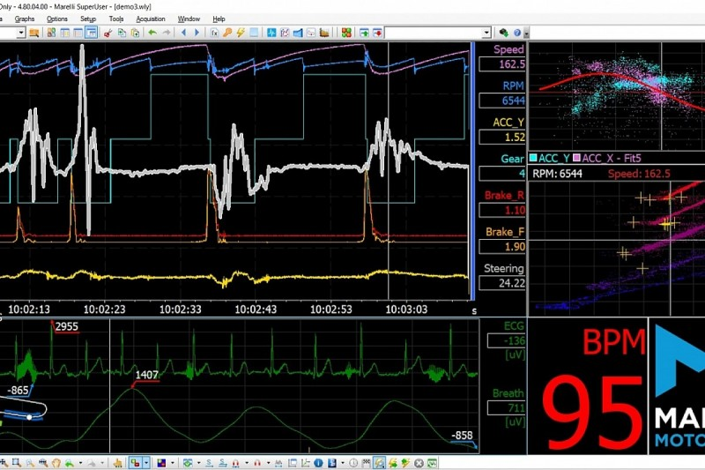
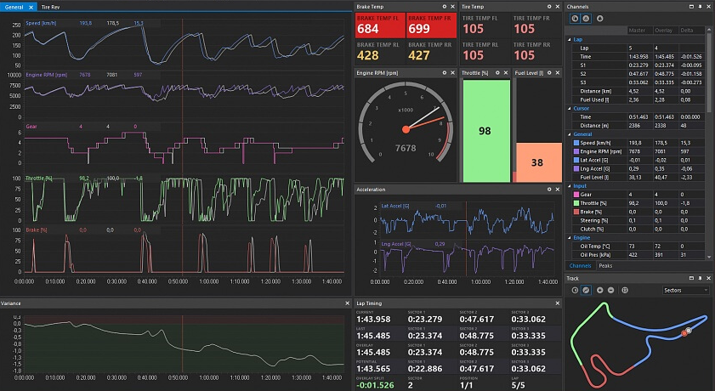
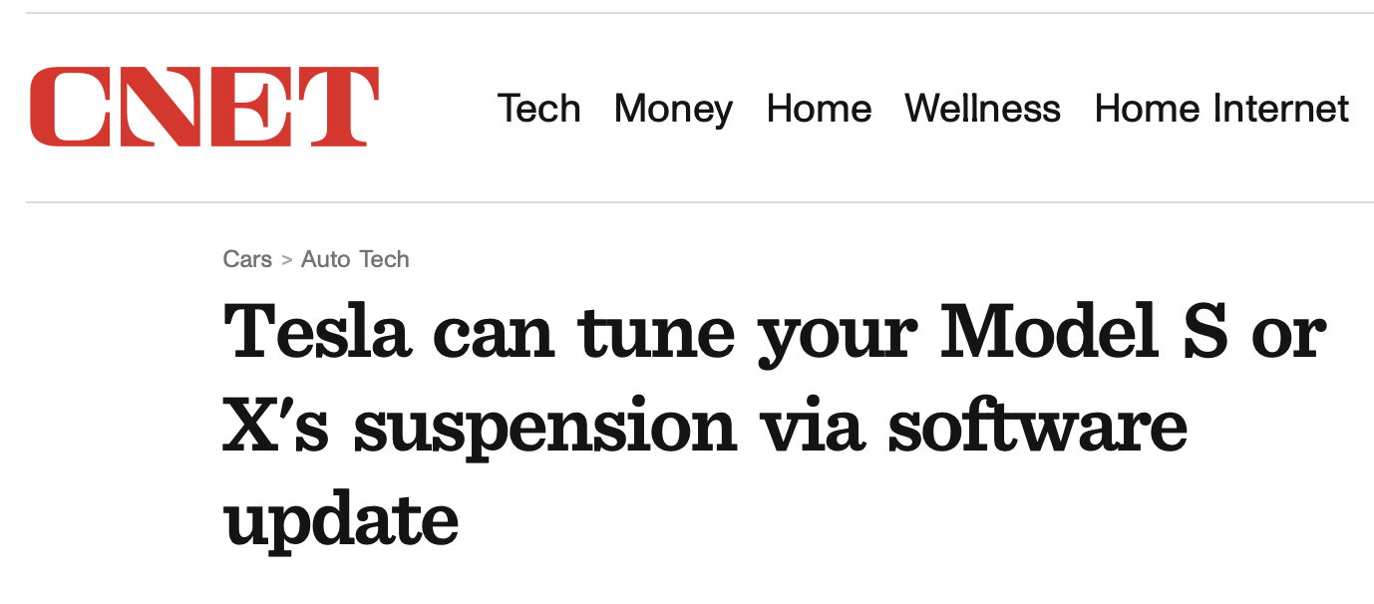
Mechanical Engineers
Realtime Diagnostics & Tuning
Notes:
It’s not just the car itself, it’s all the electronics and systems and diagnostics that can go into a car. There’s realtime tuning that can be done.
One interesting extension is an Formula 1 team that combined the racing diagnostics with biometric data, so they can monitor and optimise things like heart rate in both their racers and their pit crew.
Another extension you might have heard about is how Tesla is able to send updates to the car, remotely modifying things like suspension. This would have been done by a team of engineers that have a great understanding of both mechanical systems and software engineering.

Slide 50
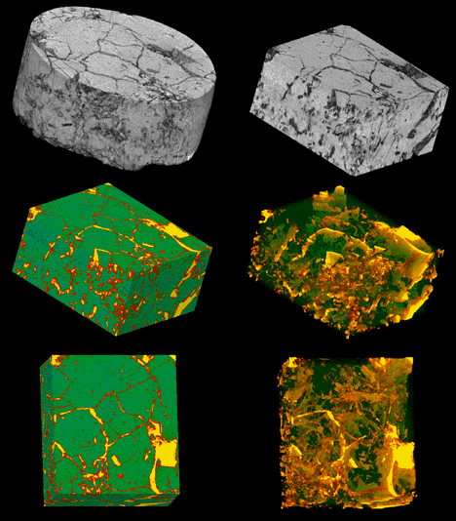
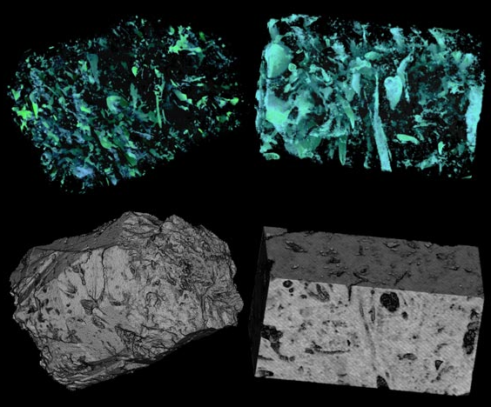
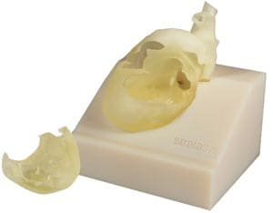
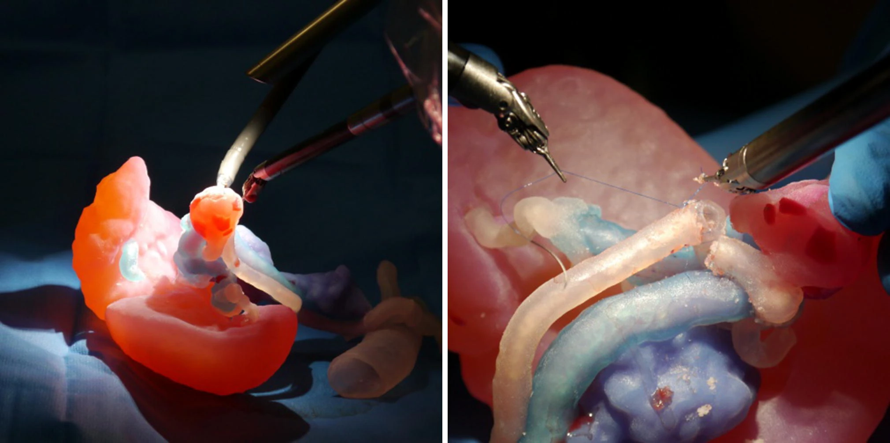
Materials Engineers
Digital Image Analysis of Material Microstructure
Notes:
There’s lots done on the image analysis of microstructures to predict different breakage patterns, Seb could talk to you a lot more about this.
From my background, another hybrid of materials and software engineering is the scanning and 3d printing organs that can be used for either practice for surgeons or and maybe in the future, organ donation candidates for those in need.

Slide 51
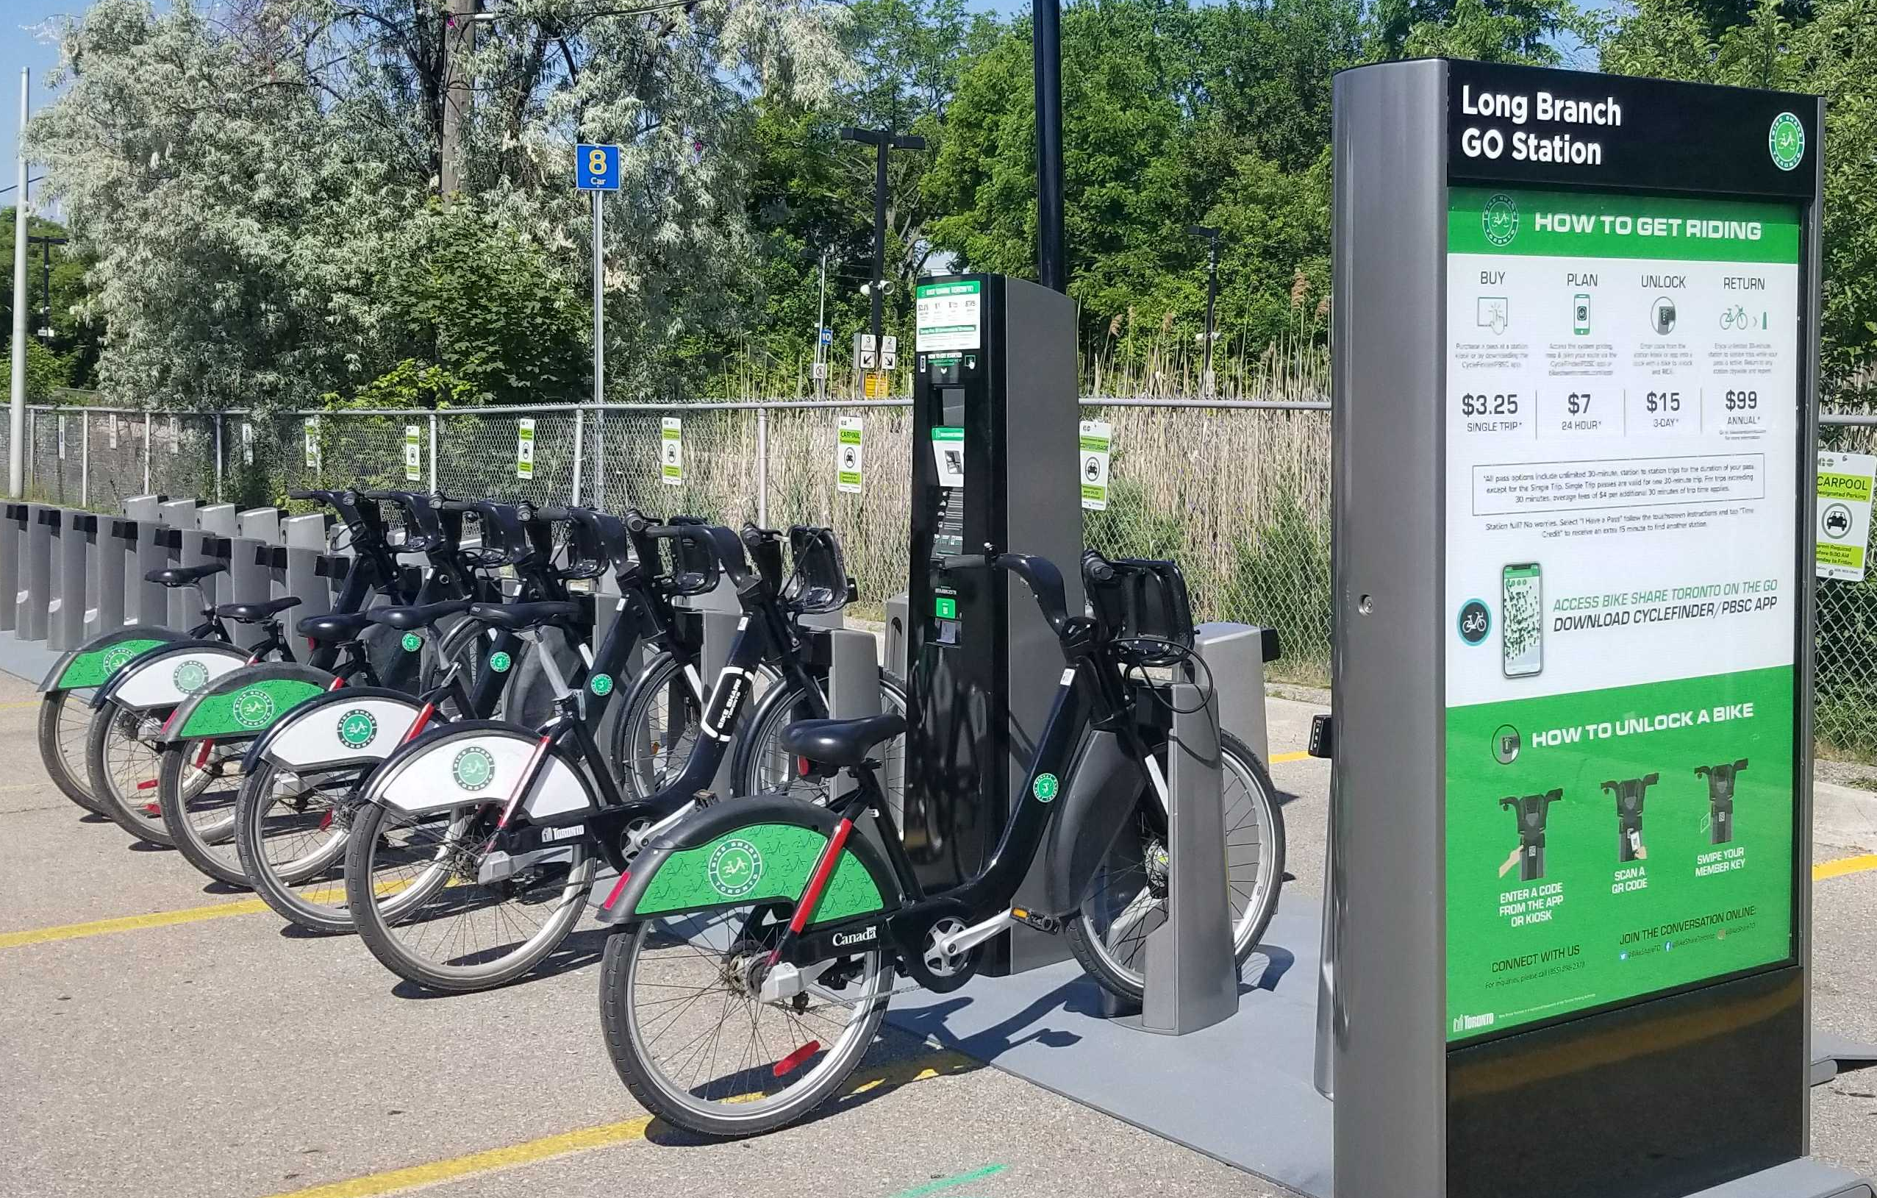
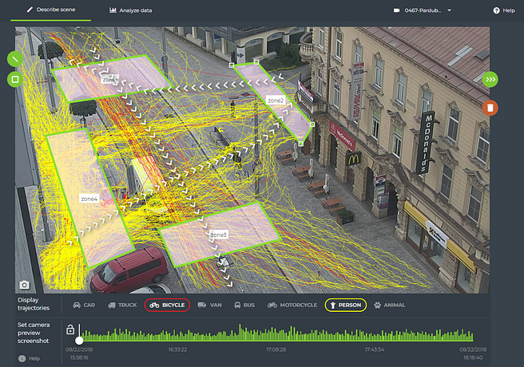

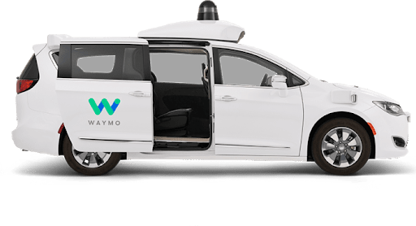

Civil Engineers
Urban Transportation Disrupted
Notes:
Civil is probably the discipline that thinks they need it the least, but probably have the most to gain by adopting it.
Civil engineering has been completely disrupted by new technology and software

Slide 52



Mineral Engineers
Semi-Autonomous Mines
Notes:
Semi-autonomous mines with self driving vehicles? Removing the human element could make elements of mining not only cheaper, but also much safer. Autonomous mining tools have also been shown to last significantly longer without manual wear and tear and misuse.

Slide 53

Chemical Engineers
Synthesizing new compounds
Notes:
Instead of doing many rounds of tests and trials what about getting the first set of results, and having AI suggesting the direction to go for the next trial so you can more efficiently develop or optimise your drug.

Slide 54







Sci-fi Inspiration
Notes:
Supercomputers that have been made with billions of computations per second, to simulate the human body
Imagine if we could simulate how the body would react to specific inputs, such as exercise, or nutrition, or vaccines?
Huge pivot in 2020 to focus on how vaccines and Covid would impact specific human bodies in different ways.

Slide 55
Programming Skills Are In Demand
According to the Developer Survey by StackOverflow, Python was one of the most in-demand technologies of 2018, 2019, 2020, and 2021.
As of 2021, it was ranked the most wanted programming language by professional software developers.

Slide 56

Python Skills Are In Demand
According to the TIOBE Index, Python overtook C and Java in 2022 as the world’s most popular programming language
Notes:
Programming skills are in demand, and Python is one of the sought after and used languages in the world.

Slide 57

Python Skills Are In Demand
Since 2024, Python has become the significantly most popular language on the planet!
TIOBE attributes this to Python’s data mining and AI libraries
Notes:
Programming skills are in demand, and Python is one of the sought after and used languages in the world.

Slide 58

One of the reasons for choosing Engineering!
Finally! A course that isn’t Chem, Bio, Physics, or Math
This (as well as your engineering design course) is what separates you from many other sciences
And makes you MUCH more valuable….

Slide 59

Before Next Class:
How Does That Work?
Modules -> Course Resources -> How Does That Work? (HDTW)
In Tutorial 0 this week -> Set up your development environment.

Slide 60
Introduction.
Week 1 | Lecture 1 (1.1)

